Slide 1
Analytics

Slide 2
What are website analytics?
Website analytics are generally referred to as the measurement, analysis and reporting of Internet activity in order to understand and optimize your website. To put this simply, it is data on:
Who visits your website
What they did once they landed there and how long they stayed
Where they went afterward
How your visitors found your website - this is very important for determining which of your efforts are paying off. It shows if visitors found your site directly, through a referral (ex: Twitter, Facebook), or from search engines.
Web browsers used by your visitors - knowing which web browsers your visitors use allows you to know which browsers you should be focusing on.
What keywords were used by visitors in the search engines to get to your website

Slide 3
Why are these important for media professionals?
Monitoring content: Analytics can show a newspaper what type of content gets the most attention and which sections of their online publications are getting the most attention, show patterns.
Monitoring audiences: Demographics and how you can best serve those demographics.
Advertising (where the money comes from): One example, newspapers can use analytics to determine where their strongest geographic audiences are located and use that to appeal to advertisers looking to reach those audiences.

Slide 4
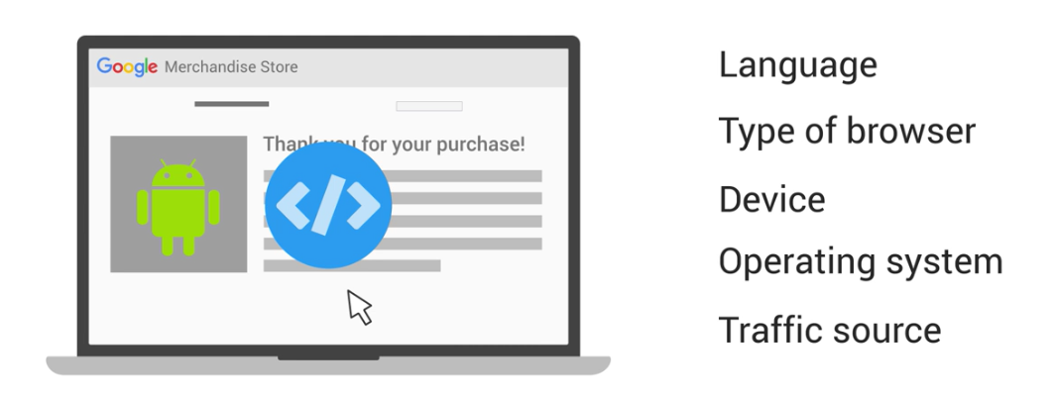
Google analytics is a popular option
Basically Google puts tracking code on your site. Based on the information collected, they can provide you with information that can be useful.

Slide 5
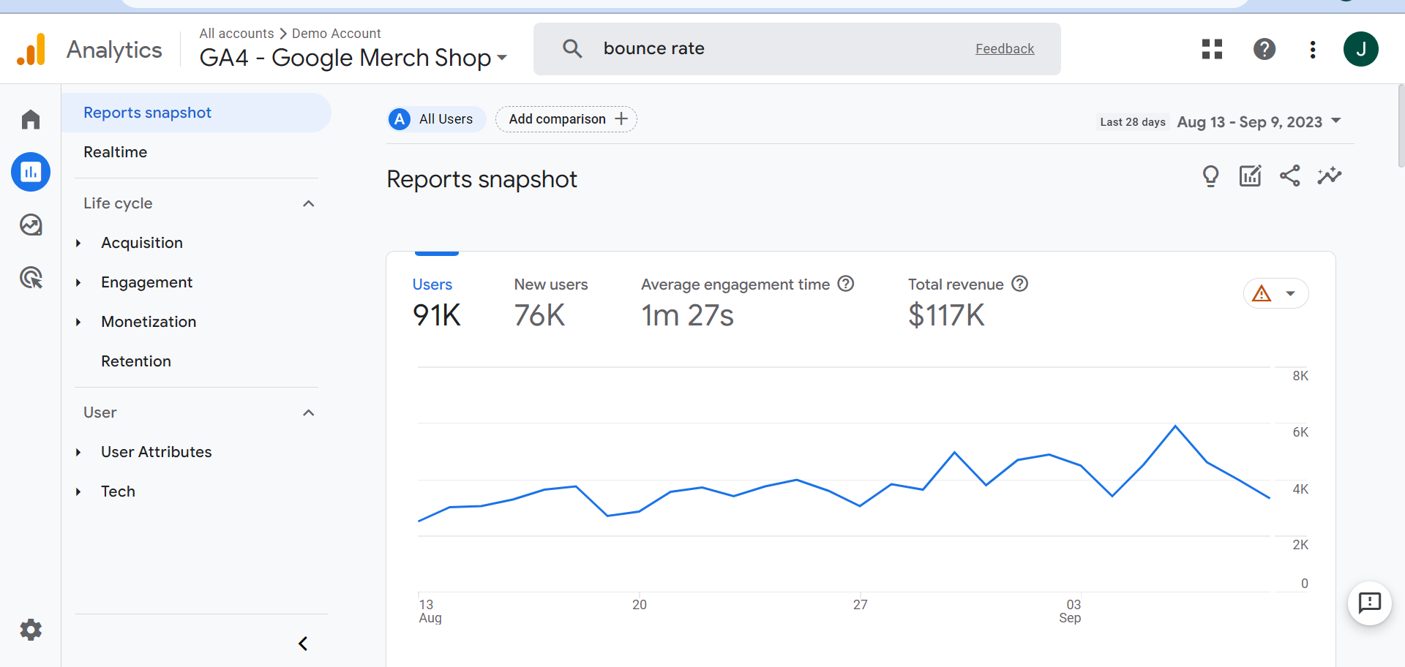
As the writer this won’t be your main job but you’ll need to be familiar with analytics. Let’s look at their demo page.

Slide 6
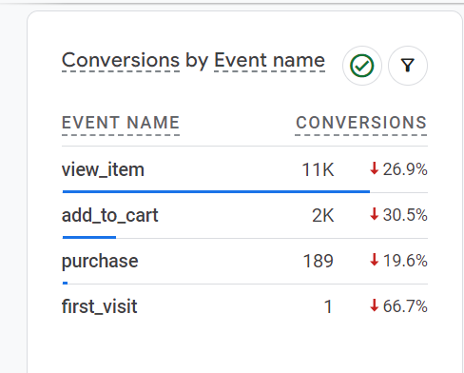
As with anything, there are terms you will need to understand. For example:
A session is a period during which a user is engaged with your website or app.
An engaged session is a session that lasts longer than 10 seconds, has a conversion event or has at least 2 pageviews or screenviews. (Can be lots of different conversions. Doesn’t mean a purchase)
Events in Google Analytics measure specific interactions on your website or app. (You designate which events you want counted as conversions). Conversions represent user actions that are valuable to your business, and to measure them in Analytics, you need to identify an important event and mark it as a conversion.

Slide 7
The engagement rate is the percentage of engaged sessions on your website or mobile app. The bounce rate is the opposite of the engagement rate. The bounce rate is the percentage of sessions that were not engaged.
An example:
For instance, a user visits your website, reads some content for less than 10 seconds, and then leaves. While they were on your website, they didn't trigger any events or visit any other pages.
In this instance because the user didn't match any of the criteria of an engaged session (the session was less than 10 seconds, no conversion event occurred, and there were not at least 2 pageviews or screenviews), the session would not count as an engaged session. If this were the only session on your website, the engagement rate would be 0% and the bounce rate would be 100%.

Slide 8
To put this in terms of a mass information provider:
Why didn’t the person stay on the article and read it?
Why didn’t they click on another link available on the page?
How did the person get to your article?

Slide 9
When data drives the news: is there a problem with readers deciding news?
Raju Narisetti of the Washington Post says it’s often difficult for those editors to suddenly accept that there is a lot of data and that the data says something about engagement, about what readers care about, what readers don’t care about, and to accept that you have to be able to use a mix of this data and your own news judgement to determine content priorities.

Slide 10
In actuality, it has other uses for publications
Analytics data is helping editors determine how, where and for how long content should be displayed.
Raju Narisetti of the Washington Post, explained how The Post uses analytics data to determine the best way to cover a particular story. "Can we do podcasts? Can we do a photo gallery? Can we do any kind of user-generated content?"

Slide 11
I encourage you to:
Google Analytics Academy is free if you’d like to really learn more.

Slide 12
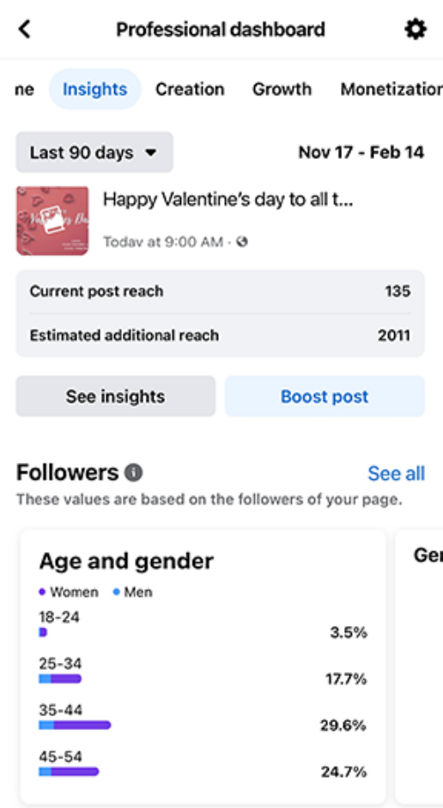
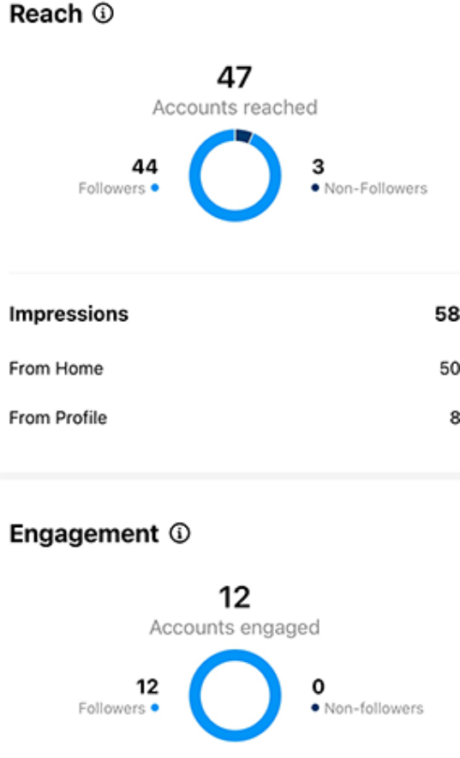
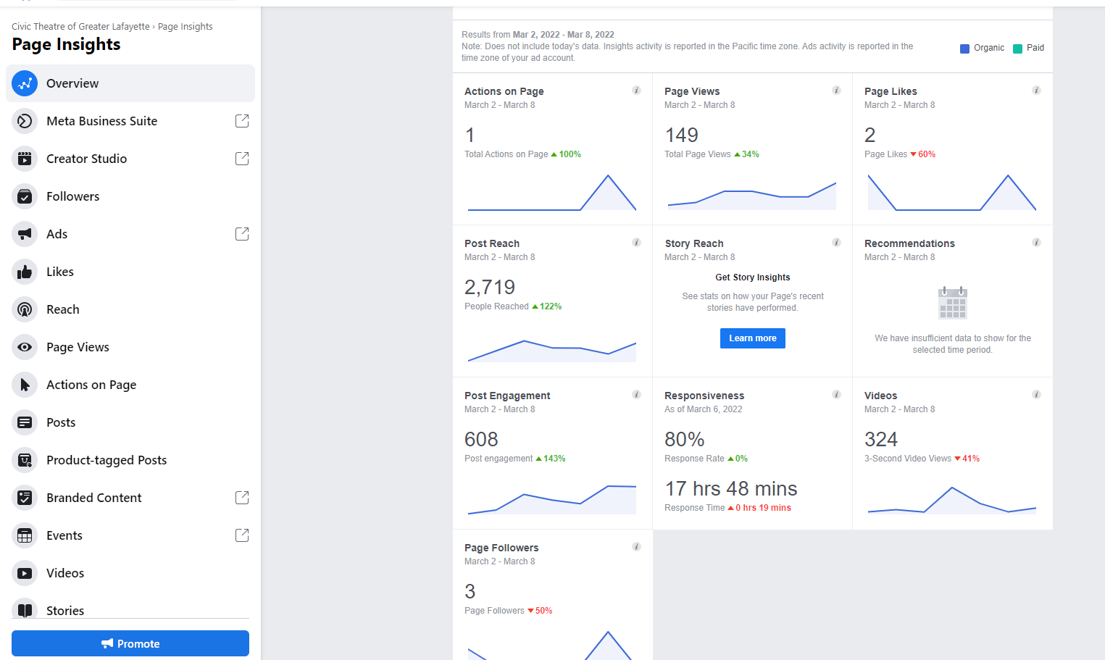
As a writer, you’ll need to keep an eye on your professional social media accounts analytics as well

Slide 13
The debate is over what metrics matter
Reach (vanity metric) vs. Engagement
No. of followers (vanity metric)
Quantity of visitors vs. Quality of visitors

